Slide 1
CSC312
Automata Theory
Lecture # 9
Chapter # 6 by Cohen
Transition Graphs

Slide 2
Deterministic FA (DFA)
The FAs that we have studied so far are DFA in that
  At every state there is exactly one outgoing transition for a character and the machine can follow the transition deterministically
    No duplicates
    No missing edges

Slide 3
Nondeterministic Finite Automata
The FA where a state can have more than one transition for the same character. This puts the machine in an indecisive state for which transition to follow
  Has duplicate transitions
  Can miss transitions for some characters

Slide 4
NFA
Reduces number of states and transitions
Costly execution
  Needs concurrent processing to find a successful path
An NFA can have a successful and unsuccessful path for the same input
If an NFA has at least one successful path for an input it is considered to be valid
Machine crashes for an undefined transition thus causing implicit reject

Slide 5
NFA Language recognition
Acceptance
  If at least one successful path exists
Rejection
  Either machine crashes on input or ]
  No successful path exists

Slide 6
NFA
Examples
  An NFA that accepts the language {bb, bbb}
  All words that contain bb in them
  All words contains a double letter

Slide 7
Epsilon Transitions
ε- Transitions
A null transition that changes state but doesn’t consume any character
Possible with NFAs and Transition Graphs (discussed next)

Slide 8
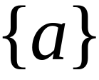


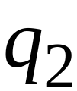


NFA
Alphabet =
Start

Slide 9
Example: Accepting
Start

Slide 10
Example: Accepting
First choice
Start
Parallel Processing
Second choice

Slide 11
Example: Accepting
Start
No transition so leave it

Slide 12
Example: Accepting
Since there is no more
symbol to read and
it is an accepting state
Therefore, the
NFA will “Accept”
Start

Slide 13
Example: Rejecting
Start

Slide 14
Example: Rejecting
Start

Slide 15
Example: Rejecting
Start
No transition

Slide 16
Example: Rejecting
No transition so leave
the state
Start
Since there is no current state or accepting state therefore, NFA will “Reject” the input string.

Slide 17
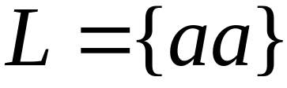
Language of the NFA
Start

Slide 18
Transition Graphs
Relaxed input conditions
Can read multiple characters before making a transition
Thus every edge can be labeled with a substring instead of a single character
Can have multiple start states

Slide 19
Transition Graphs
Examples
  All words that start and end with a double letter
a,b
aa,bb
-1
2
aa,bb
+3

Slide 20
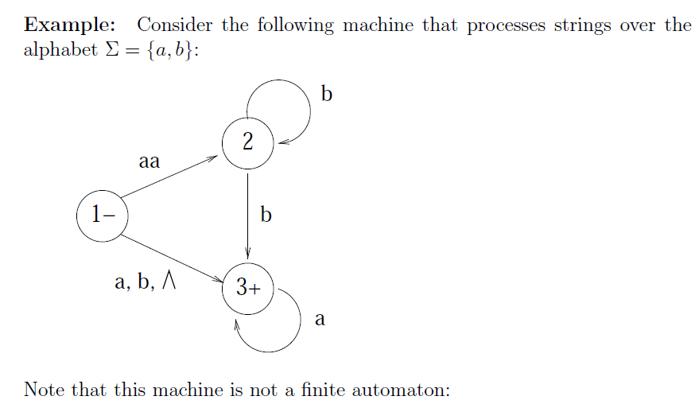
Examples

Slide 21
The arc from state 1 to state 2 is labeled with the string aa, which is not a single letter.
There are two arcs leaving state 2 labeled with b.
There is no arc leaving state 2 labeled with a.
There is an arc from state 1 to state 3 labeled with , which is not a letter from .
There is no arc leaving state 3 labeled with b.

Slide 22
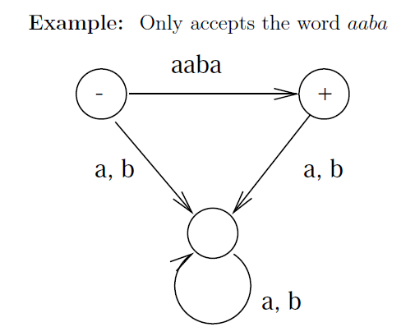

Slide 23
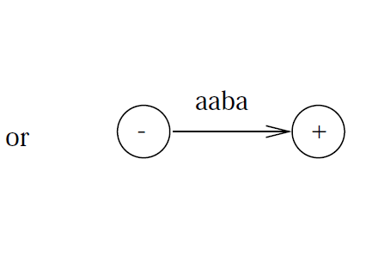

Slide 24
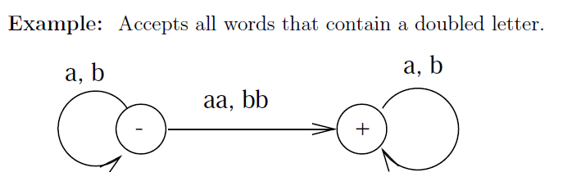

Slide 25
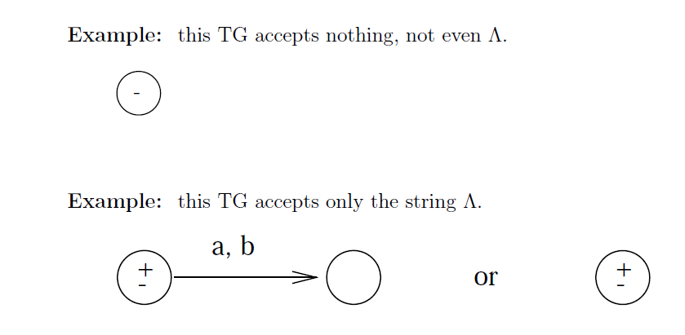

Slide 26
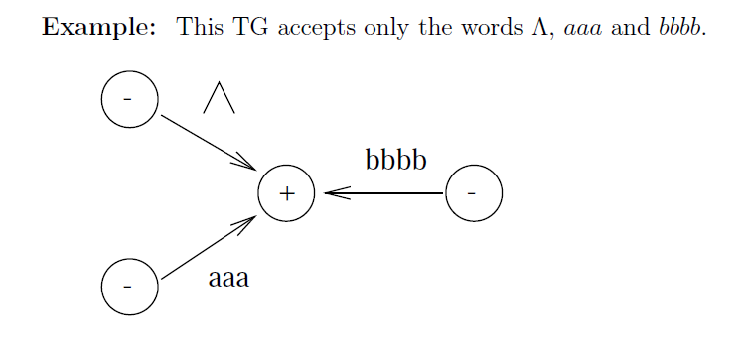

Slide 27
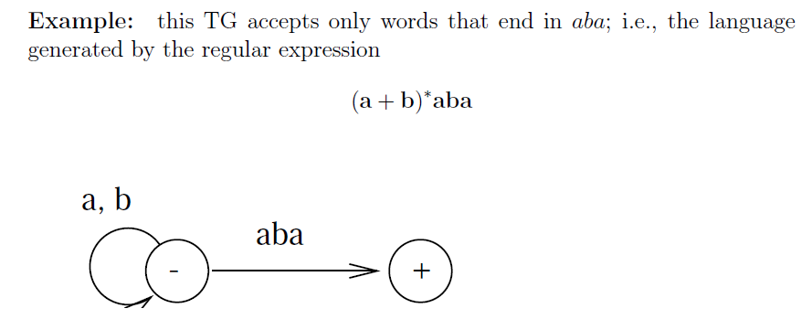

Slide 28
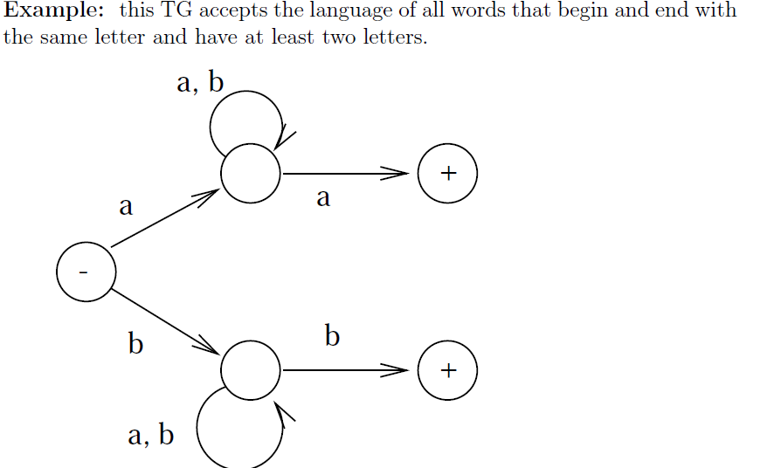

Slide 29
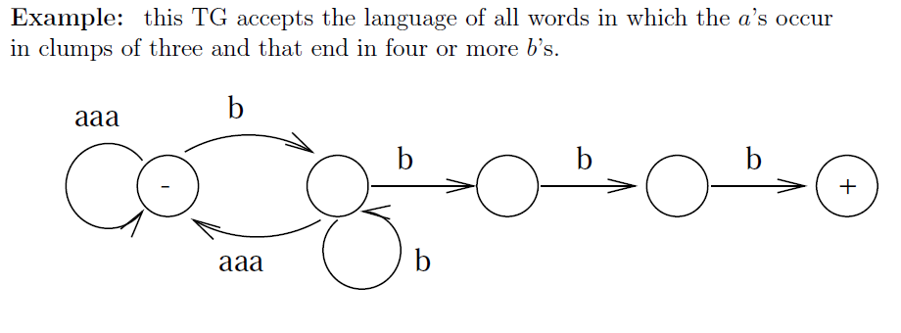

Slide 30
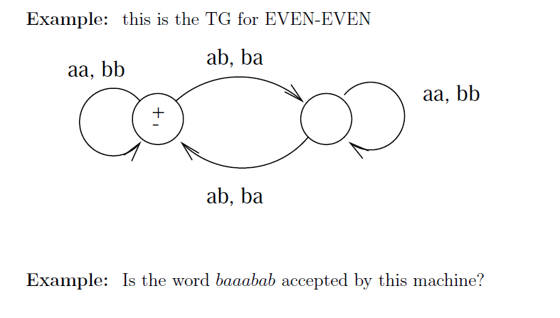

Slide 31
Transition Graphs
Examples
  All words that have al least one double letter in them
  All words that begin and end with different letters
  All words in which a occurs only in even clumps and that end in three or more bs
  All words that have even number of letters

Slide 32
Generalized Transition Graphs
A variation of TG
A generalized transition graph is a collection of three things
  A finite set of states, of which at least one is a start state and some (may be none) are final states
  An alphabet ∑ of input letters
  Directed edges connecting some pairs of states each labeled with a regular expression

Slide 33
Generalized Transition Graphs
a*
a*
(ba +a)*
(b + Λ)
-1
2
3
This machine accepts all strings without a double b

Slide 34
GTGs
Examples
  All words having even number of as and bs
  All words that start with ab
  All words having as in clumps of even numbers and end at one or more bs

Slide 35
Definition
A transition graph, abbreviated TG, is a collection of three things:
1. A finite set of states at least one of which is designated as the start state (-) and some (maybe none) of which are designated as final states (+).
2. An alphabet Σ of possible input letters from which input strings are formed.
3. A finite set of transitions that show how to go from one state to another based on reading specified substrings of input letters (possibly even the null string Λ).

Slide 36
Transition Graphs
Clause 3 in the definition means that every edge is labeled by some string or strings of letters, not necessarily only one letter.
Successful path:
A series of edges forming a path beginning at some start state and ending at a final state.

Slide 37
Examples of TG
All the states having some start states but not necessary.
We can represent Even-Even example:
aa
-
+
bb

Slide 38
Important Notes
There may exist more than one paths for certain string, while there may not exist any path for certain string as well.
If there is at least one path for a certain string, the string is supposed to be accepted by the TG, otherwise the string is supposed to be rejected.
Collection of accepted strings is the language accepted by the TG.

Slide 39
Important Notes (Cont…)
There are two different ways that an input string can be rejected;
The machine peacefully trace a path ending a non-final state
It could crash while being processed.
Every FA is a TG as well, but the converse may not be true i.e. every TG may not be an FA

Slide 40
TG
FA is deterministic that is why it is also known as Deterministic Finite Automata (DFA), while TG is non-deterministic.
The ultimate path through the machine is not determined by the input alone. Human choice becomes a factor in selecting the path; the machine does not make all its own determinations.

Slide 41
Generalized Transition Graphs (GTG)
A generalized transition graph, abbreviated GTG, is a collection of three things:
1. A finite set of states, of which at least one is a start state (-) and some (maybe none) are final states (+).
2. An alphabet Σ of possible input letters.
3. Directed edges connecting some pairs of states, each labeled with a regular expression.

Slide 42
Examples of GTG
The major difference b/w TG & GTG is that TG is represented using substrings while GTG is represented using RE(regular expression).

